Slide 1
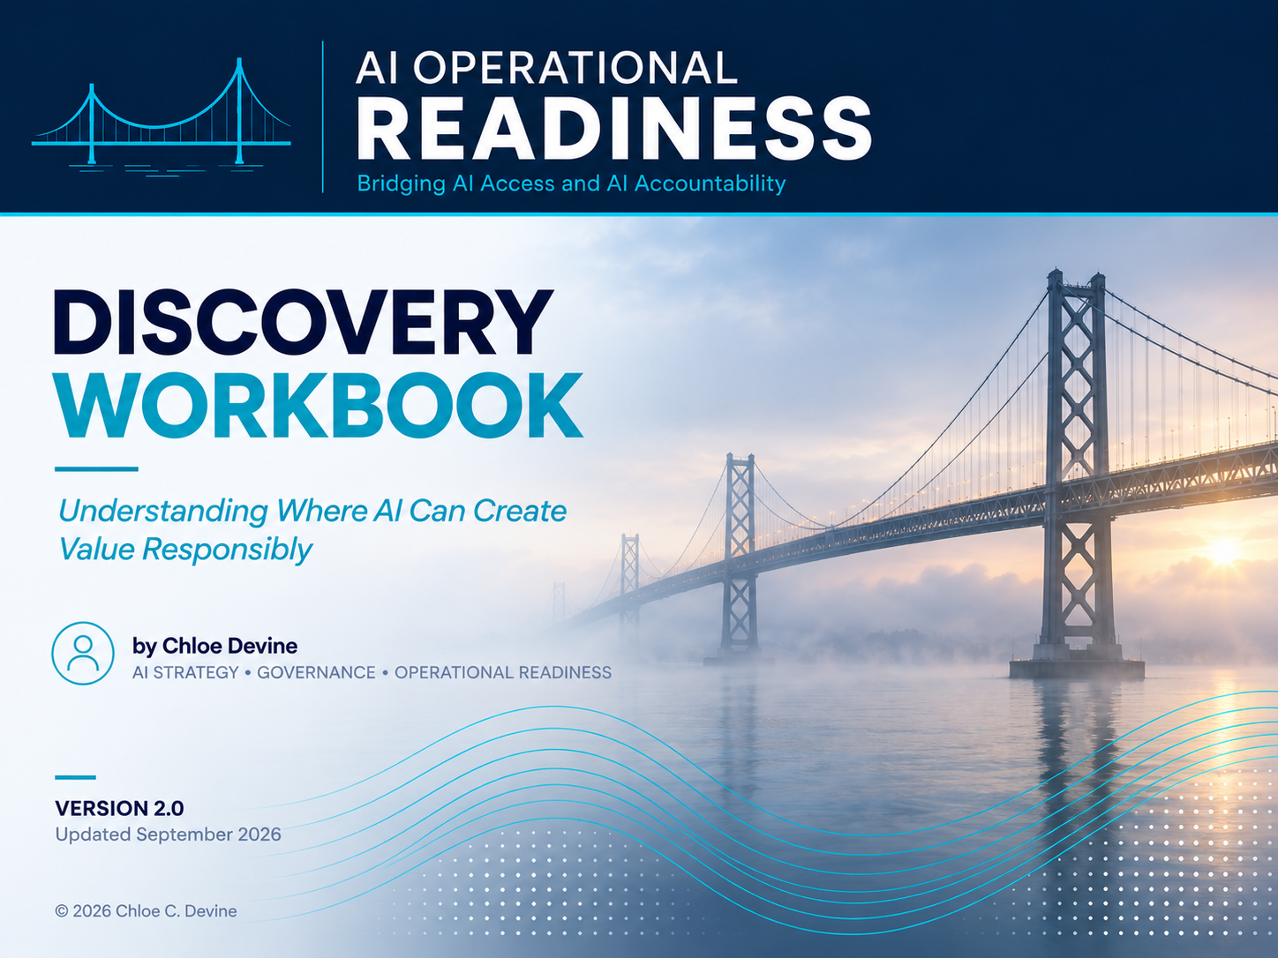

Slide 2
Discovery Overview
AI Operational Readiness • Discovery Workbook
Purpose
This workbook is designed to help organizations identify where AI can create value responsibly by examining:
People
Process
Technology
Governance
Guiding Philosophy:
AI Operational Readiness begins by understanding work, not by selecting tools.
What We’re Looking For
Identify | Understand | Evaluate
Friction | Workflows | Opportunities
Repetition | Bottlenecks | Risks
Handoffs | Data | Human Oversight
Pain Points | Dependencies | Business Impact
© 2026 Chloe C. Devine
Guiding Principles
Start with work, not tools
Focus on outcomes, not hype
Preserve opportunities based on value and risk
Adopt AI responsibly and measurably
This workbook helps organizations:
Identify friction
Understand work
Evaluate opportunities
Preserve accountability

Slide 3
Discovery Mode
AI Operational Readiness • Discovery Workbook
Choose the discovery lens based on the current state of the work.
Proposed AI | Existing or In-Flight AI
Understand how the work happens today | Reconstruct how the AI-enabled work actually operates
Identify friction, pain, dependencies, and business need | Trace workflow, AI use, dependencies, oversight, evidence, and ownership
Determine whether AI is an appropriate opportunity | Identify operational gaps, risks, workarounds, and improvement needs
Output: Opportunity signals and current-state observations | Output: Operational findings and current-state observations
Both modes begin with the work as it happens – not with the AI tool.

Slide 4
People
AI Operational Readiness • Discovery Workbook
Understanding how work gets done
Key Questions
Where do teams spend the most time?
What work feels repetitive?
Where are handoffs painful?
What frustrates employees?
Where do people spend time gathering information?
What work requires constant context switching?
What knowledge lives only in people’s heads?
Observations
Signal
Pattern
Opportunity
Opportunity Signals
Repetition • Manual effort • Context switching • Rework • Delays • Knowledge gaps

Slide 5
Process
AI Operational Readiness • Discovery Workbook
Understanding how work moves
Key Questions
What workflows exist?
Where are bottlenecks occurring?
Which approvals create delays?
What work is duplicated?
Which tasks require manual coordination?
What information must be copied between systems?
Where do errors or rework commonly occur?
Where does the way work happens differ from the documented or expected process?
What workarounds have become part of normal operations?
Observations
Bottleneck
Pattern
Opportunity
Opportunity Signals
Manual effort • Rework • Delays • Duplicate steps • Approval friction • Handoffs • Waiting

Slide 6
Technology
AI Operational Readiness • Discovery Workbook
Understanding what tools enable work
Key Questions
What tools are currently used to complete this work?
Where are employees already using AI or automation?
Is Microsoft Copilot, ChatGPT, Claude, Gemini, or another tool available?
What data, documents, or knowledge sources does the work depend on?
How easy is it for teams to access the information they need?
Which systems do not connect well today?
Where do employees copy, paste, export, or manually move information?
What tool limitations create friction?
What information are people repeatedly extracting or copying?
What does this AI-enabled work depend on in order to function?
Which of these dependencies can change independently of the workflow?
Observations
Constraint
Pattern
Opportunity
Opportunity Signals
Disconnected systems • Manual data movement • Poor search • Repeated copy/paste • Low tool adoption • Shadow AI use • Data access barriers

Slide 7
Governance
AI Operational Readiness • Discovery Workbook
Understanding where accountability lives
Key Questions
Where is human review required?
Which decisions require a human to remain accountable?
What information is sensitive?
What happens if this work is wrong?
Who approves outputs?
Who owns the process?
Who has the authority to intervene or stop the process?
What decisions affect customers?
Where are regulations involved?
What risks concern leadership?
Which decisions would have significant consequences if they were to go wrong?
What assumptions or conditions does the current process rely on to operate safely or appropriately?
Have any of those conditions changed?
Observations
Risk
Pattern
Opportunity
Opportunity Signals
Sensitive information • Human review • Compliance obligations • Regulatory exposure • Customer impact • Approval requirements • High-consequence decisions • Missing ownership
Notes:
Examples of High-consequence decisions are decisions where being wrong materially harms people, money, customers, compliance, reputation, or operations.

Slide 8
Measurement
AI Operational Readiness • Discovery Workbook
Understanding how success is evaluated
Key Questions
How is this work measured today?
What outcomes matter most?
What does “better” look like?
What metrics already exist?
Where is performance hard to measure?
What would indicate AI is creating value?
What would indicate AI is creating unintended consequences, risk or rework?
What evidence would leadership need before scaling?
What important questions about this work are difficult to answer today because the necessary evidence isn’t captured?
Observations
Gap
Pattern
Opportunity
Opportunity Signals
Unclear success metrics • Manual reporting • Anecdotal value • Hidden rework • Quality issues • Review burden • Adoption uncertainty • Missing baseline • No scale criteria
Notes:
An example of review burden is how much time it takes to verify that AI didn’t make a mistake. Let’s say you have meeting notes and it took 30 minutes to write the notes without AI. With AI it took 5 minutes to generate and 5 minutes to review, meaning you gained 20 minutes so it is a low burden. Organizations often measure faster generation but forget to measure time spent checking outputs, number of corrections, human approval effort, escalations, and rework.

Slide 9
Adoption
AI Operational Readiness • Discovery Workbook
Understanding how change becomes durable
Key Questions
Where are employees already experimenting with AI?
What teams are most receptive to change?
What concerns or resistance exist?
Where do people lack confidence using AI?
How has AI changed the work rather than simply automated it?
Has AI reduced effort or shifted effort to reviewers?
What new skills or behaviors are required?
How are managers supporting adoption?
How are successes and lessons being shared?
What do users do when they don’t trust the AI output?
Observations
Barrier
Pattern
Opportunity
Opportunity Signals
Shadow AI uses • Resistance • Low trust • Review burden • Training gaps • Uneven adoption • Key-person dependency • Informal workarounds • Knowledge silos • Localized Successes

Slide 10
AI Continuity & Resilience
AI Operational Readiness • Discovery Workbook
Identify where AI dependency could create operational fragility
Key Questions
What AI-enabled workflows depend on a specific model, vendor, API, or platform?
What happens if the primary model becomes unavailable for 24 hours?
What happens if it is unavailable for 7 days?
What happens if access is permanently restricted?
What business processes stop functioning?
What processes degrade gracefully?
What processes can continue manually?
What workflows still require retained human expertise?
Has the organization preserved enough knowledge and staffing capacity to recover?
Has the fallback or manual process been tested recently?
Observations
Constraint
Pattern
Opportunity
Opportunity Signals
Single-model dependency • No fallback path • Manual process no longer documented • Human expertise reduced • Critical workflow depends on AI • Vendor/API access risk • Recovery owner unclear

Slide 11
Escalation & Response
AI Operational Readiness • Discovery Workbook
Understanding how issues are managed
Key Questions
How are issues identified?
Who is notified?
What information must be preserved?
What would trigger a pause or shutdown?
How are incidents communicated?
Who has authority to intervene?
What lessons are captured afterward?
How are near misses identified and reported?
What decisions and/ or thresholds would trigger escalation?
Who can pause or override the process?
What happens while an issue or escalation is unresolved?
Observations
Failure Point
Pattern
Opportunity
Opportunity Signals
Missed handoffs • Delayed decisions • Escalation confusion • Incident uncertainty • Silent failures • Missing Evidence • Ownership gaps • No pause criteria
Notes:
Silent failure examples include:
- Hallucinations that aren't reported.
Employees quietly working around AI.
Review burden increasing.
Low trust causing abandonment.
Near misses are “tell me about the things that almost became a crash.”

Slide 12
Ownership
AI Operational Readiness • Discovery Workbook
Understanding who is accountable
Key Questions
Who owns this work today?
Who would own AI-enabled workflows?
Who can propose, approve, implement, and communicate changes to the process or AI-enabled workflow?
Who is accountable for outcomes?
Who is responsible for monitoring performance?
Who responds when issues occur?
Which decisions require escalation?
Where are responsibilities unclear?
What dependencies exist across teams?
Where does accountability fall between organizational boundaries?
Observations
Ambiguity
Pattern
Opportunity
Opportunity Signals
Shared responsibility • Missing ownership • Role confusion • Cross-functional dependencies • Approval bottlenecks • Escalation uncertainty • Competing priorities • Organizational silos

Slide 13
AI Operational Readiness Themes
AI Operational Readiness • Discovery Workbook
Synthesizing what we heard
Domain | Observation | Pattern | AI Opportunity/ Operational Finding
People | Pain Points
Process | Bottlenecks
Technology | Constraints
Governance | Risks
Measurement | Gaps
Adoption | Barriers
Continuity | Constraints / Fragility
Escalation | Failure points
Ownership | Ambiguities
Next Step
Translate themes into AI opportunities and operational findings.
AI opportunities: prioritize based on frequency, pain level, complexity, AI fit, risk, and business impact.
Operational findings: route to the appropriate design, governance, evidence, or operational-readiness workstream.

Slide 14
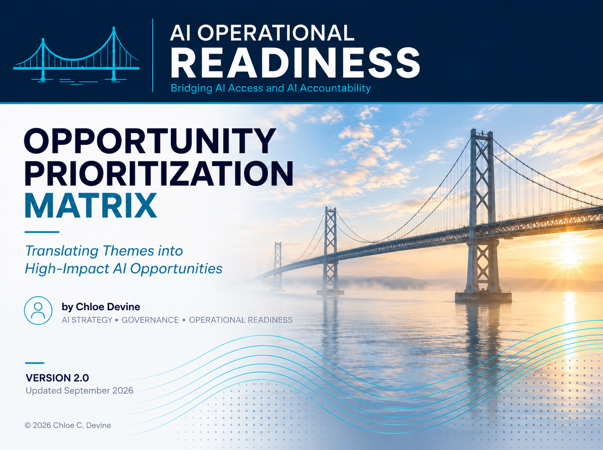

Slide 15
Prioritization Matrix Overview
AI Operational Readiness • Opportunity Prioritization Matrix
Purpose
The matrix answers: “Of all the AI opportunities we heard, which ones are worth pursuing first?”
Opportunity | Source Theme | Frequency | Pain Level | Complexity | AI Fit | Risk | Business Impact | Continuity Risk | Priority
… | … | … | … | … | … | … | … | … | …
Scoring: Use a simple 1-5 scale
Frequency
1 = Rare, 5 = Happens constantly
Pain Level
1 = Minor annoyance, 5 = Major friction
Complexity
1 = Easy to implement, 5 = Hard to implement
AI Fit
1 = Weak Fit, 5 = Strong Fit
Risk
1 = Low Risk, 5 = High Risk
Business Impact
1 = Low Value, 5 = High Value
Continuity Risk*
1 = Low Risk, 5 = High Risk
Priority Labels
Priority Formula
Score | Priority
12+ | High
8-11 | Medium
7 or below | Low
Priority Score = Frequency + Pain Level + AI Fit + Business Impact – Complexity – Risk
The Priority Score supports comparison across opportunities; it does not replace practitioner judgment.
Example Row:
Opportunity | Source Theme | Frequency | Pain Level | Complexity | AI Fit | Risk | Business Impact | Priority
Automate meeting summary drafts | People/ Adoption | 5 | 3 | 2 | 5 | 2 | 4 | 13 (High)
*Continuity Risk is tracked separately and does not affect the Priority Score. It identifies operational dependencies that should be addressed if the opportunity advances.
Notes:
Source Theme should indicate where the opportunity emerged during the Discovery Workbook conversations.
People
Process
Technology
Governance
Measurement
Adoption
Escalation
Ownership
Complexity considers:
- Process Change
- Technical Integration
- Data Readiness
- Stakeholder Coordination
- Change Management
Risk considers:
- Data Sensitivity
- Decision Consequence
- Human Oversight
- External Exposure
- Compliance / Reputation

Slide 16
Scoring
AI Operational Readiness • Opportunity Prioritization Matrix
Factor | Score
Frequency | 1 – Rare/ occasional 2 - Monthly 3 - Weekly 4 - Daily 5 – Multiple times per day or constant
Pain Level | 1 – Minor inconvenience; work is generally manageable 2 – Noticeable friction or occasional frustration 3 – Meaningful inefficiency affecting productivity 4 – Significant bottleneck, or rework, or delay 5 – Major operational pain affecting outcomes, quality, or customer experience
AI Fit | 1 – Weak fit; AI adds little value 2 – Possible fit with human review 3 – Reasonable fit with human review 4 – Strong fit for assistive use 5 – Excellent fit; repeatable, language/knowledge-heavy, high-volume work
Business Impact | 1 – Low value / convenience only 2 – Small efficiency gain 3 – Meaningful team-level improvement 4 – Significant business value 5 – Strategic, financial, customer, or operational impact
Continuity Risk Tracked separately from the Priority Score to identify operational dependencies that should be addressed if the opportunity advances. | 1 – AI outage causes inconvenience only. Work continues with little disruption. 2 – Work slows, but the team has a clear manual workaround or fallback tool. 3 - Workflow slows or causes manual workaround 4 – Major disruption. Customer, operational, compliance, or revenue impact is likely if outage lasts beyond 24-48 hours. 5 – Critical failure. Workflow stops, key expertise is unavailable, or the organization cannot recover without significant external help.

Slide 17
Complexity Score
AI Operational Readiness • Opportunity Prioritization Matrix
Calculate complexity from 5 factors, each scored 1-5. Complexity Score = average of the five complexity factors.
Complexity Factor | Score
Process Change | 1 - Minimal or no workflow change required 2 - Small adjustment to existing work 3 - Moderate redesign affecting one team 4 - Significant changes involving multiple teams 5 - Major transformation of workflows across organization
Technical Integration | 1 - No integration required 2 - One system connection 3 - Several systems connected 4 - Multiple complex integrations 5 - Enterprise-wide integration effort
Data Readiness | 1 – Clean, accessible, structured data already exists 2 – Minor preparation required 3 – Some gaps or quality concerns 4 – Significant cleanup or access issues 5 – Data unavailable, fragmented, or poorly understood
Stakeholder Coordination | 1 – Single owner or team 2 – Two teams involved 3 – Several stakeholders need alignment 4 – Cross-functional coordination required 5 – Enterprise-wide coordination and governance required
Change Management | 1 – Little to no training required 2 – Minor communications and training 3 – Moderate changes in behavior or skills 4 – Significant adoption effort required 5 – Major organizational change initiative
Score Range | Complexity
1.0 - 1.9 | Low
2.0 - 2.9 | Low-Moderate
3.0 – 3.9 | Moderate
4.0 – 4.5 | High
4.6 – 5.0 | Very High
Example:
(4+3+2+4+3) / 5 = 3.2

Slide 18
Risk Score
AI Operational Readiness • Opportunity Prioritization Matrix
Calculate risk from 5 factors, each scored 1-5. Risk Score = the average of the five risk factors.
Risk Factor | Score
Data Sensitivity | 1 – Public Information 2 – Internal Information 3 – Confidential business information 4 – Sensitive customer or employee information 5 – Highly regulated or legally protected information
Decision Consequence | 1 – Minor inconvenience; easily reversible 2 – Localized operational impact; readily remediated 3 – Moderate business impact requiring remediation 4 – Significant financial, customer, or reputational impact; difficult to reverse 5 – Severe legal, regulatory, safety, or brand consequence; difficult or impossible to reverse
Oversight & Accountability Requirement | 1 – Human review optional 2 – Human review recommended 3 – Human approval normally expected 4 – Human approval required 5 – Human accountability legally or operationally mandatory
External Exposure | 1 – Internal-only 2 – Limited audience 3 – Broad internal use 4 – Customer or partner-facing 5 – Public or regulatory exposure
Compliance / Reputation | 1 – Minimal concerns 2 – Low concerns 3 – Moderate concerns 4 – Significant exposure 5 – High regulatory or reputational consequences
Score Range | Risk
1.0 - 1.9 | Low
2.0 - 2.9 | Low-Moderate
3.0 – 3.9 | Moderate
4.0 – 4.5 | High
4.6 – 5.0 | Very High
Example:
(4+3+2+4+3) / 5 = 3.2

Slide 19
Opportunity Drivers vs Implementation Friction
AI Operational Readiness • Opportunity Prioritization Matrix
Priority Score Components
Opportunity Drivers (+)
Frequency
Pain Level
AI Fit
Business Impact
Implementation Friction (-)
Complexity
Risk
Continuity Risk – tracked separately as an operational dependency indicator.
Understanding how work moves
Priority | Recommended Action
High | Advance for classification and design
Medium | Refine, investigate, or defer
Low | Hold or revisit later
Priority Score
Opportunity Drivers – Implementation Friction
Example Opportunity Profiles
Opportunity | Priority | Notes
Meeting summary drafts | High | Quick win
Knowledge search assistant | High | Strong AI fit
Contract review automation | Medium | Higher risk
Automated customer refunds | Low | High consequence and risk

Slide 20
AI Operational Readiness • Opportunity Prioritization Matrix
Opportunity Prioritization Themes
Translating opportunities into action
Component | Purpose
Opportunity Drivers | Identify value
Implementation Friction | Understand effort and risk
Priority Score | Balance value and friction
Recommended Action | Guide next steps
Understanding how work moves
Next Steps
Advance selected opportunities to AI use-case classification to identify the capability pattern before designing the future-state workflow.

Slide 21
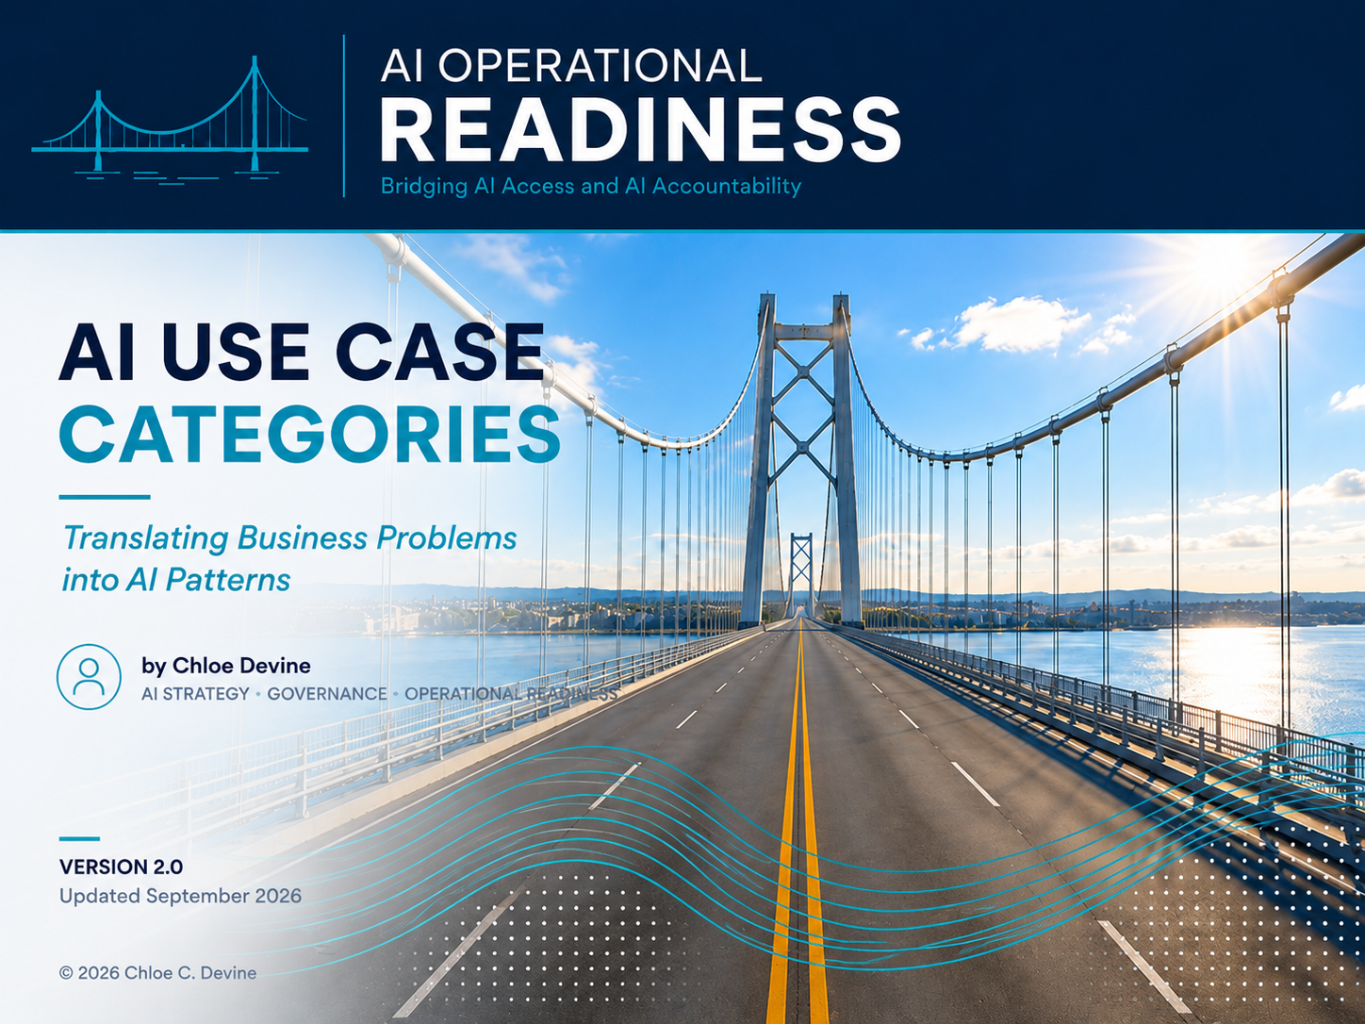

Slide 22
Framework Overview
AI Operational Readiness • AI Use Case Categories
Understanding how AI problems become repeatable patterns
Purpose
AI use cases are often unique in context but repetitive in pattern. This framework helps teams classify opportunities into common categories that can guide design, governance, and implementation.
A use case may combine multiple capability patterns. Classify the primary pattern and any supporting patterns needed to perform the work.
Why It Matters
Organizations frequently say:
“We need AI.”
The more useful question is:
“What kind of AI capability does this work require?”
Guiding Philosophy
Business problems are often unique in context but repetitive in pattern.
Notes:
Participants
- PM
- Process Owner
- SMEs
- Architects
- Governance
- Security
- Data
- Sponsors

Slide 23
Knowledge Use Cases
AI Operational Readiness • AI Use Case Categories
Understanding and finding information
Category | Purpose
Search | Locate information
Summarization | Condense information
Extraction | Convert documents into structured data
Translation | Adapt language or formats
Examples
Meeting notes
Policies
Contracts
Knowledge bases
Opportunity Signals
Search burden • Tribal knowledge • Duplicate effort • Repeated questions • Spreadsheet dependency • Context switching • Manual review
Why This Matters
Knowledge work often begins with finding, understanding, and organizing information before decisions are made.

Slide 24
Content Use Cases
AI Operational Readiness • AI Use Case Categories
Creating and organizing information
Category | Purpose
Draft | Create first versions
Classification | Categorize content
Rewriting | Improve tone or clarity
Tagging | Organize information
Examples
Emails
Reports
Job descriptions
Customer communications
Opportunity Signals
Drafting • Rewriting • Classification • Tagging • Communication burden • Inconsistent outputs • Manual documentation
Why This Matters
Content work benefits from improving consistency, speed, and quality rather than replacing human authorship.
Notes:
Outputs - Constraints include:
Pain points
Delays
Review burden
Waiting
Organizational silos
Technology limitations
Policy restrictions

Slide 25
Analysis Use Cases
AI Operational Readiness • AI Use Case Categories
Supporting decisions
Category | Purpose
Recommendations | Suggest actions
Pattern Detection | Identify trends
Decision Support | Surface insights
Risk Detection | Highlight anomalies
Examples
Incident reports
Customer feedback
Financial analysis
Opportunity Signals
Pattern recognition • Risk assessment • Decision support • Trend analysis • Reporting burden • Insight generation
Why This Matters
Analysis use cases help humans make better decisions rather than transferring accountability to AI.
Notes:
Outputs - Constraints include:
Pain points
Delays
Review burden
Waiting
Organizational silos
Technology limitations
Policy restrictions

Slide 26
Workflow Use Cases
AI Operational Readiness • AI Use Case Categories
Coordinating work
Category | Purpose
Routing | Direct work
Monitoring | Watch thresholds
Escalation Support | Surface issues
Notifications | Trigger actions
Examples
Ticketing
Service Requests
Compliance reviews
Opportunity Signals
Routing • Monitoring • Notifications • Escalation triggers • Bottlenecks • Waiting • Coordination burden
Why This Matters
Workflow use cases improve how work moves across people, teams, and systems.
Notes:
Extraction = turning information buried inside documents, emails, images, or conversations into structured data that can be used elsewhere.
Example:
Invoice Processing:
Current State
Someone opens a PDF invoice and manually enters:
Vendor name
Invoice number
Amount
Due date
into SAP or Excel.
AI Assistance
Extract those fields automatically.

Slide 27
Agentic Use Cases
AI Operational Readiness • AI Use Case Categories
Executing multi-step tasks
Category | Purpose
Tool-Using Assistant | Interacts with systems or tools to complete bounded tasks
Guided Workflow | Assists a human through defined steps
Multi-Step Agent | Performs a sequence across steps/tools
Autonomous Agent | Independently selects and executes actions within defined authority.
Examples
HR onboarding
Customer service
Procurement
Opportunity Signals
Multi-step processes • Cross-system work • Repeated approvals • Coordination overhead • Manual orchestration
Why This Matters
As AI takes on multi-step work or execution authority, governance must address the scope of authority, human intervention, escalation, and the consequencea or autonomous action.

Slide 28
Extraction Explained
AI Operational Readiness • AI Use Case Categories
Turning unstructured information into structured data
Current State | AI Assistance
Someone reads invoices manually and enters values into SAP or Excel | AI extracts vendor name, invoice number, amount, and due date automatically
Examples
Invoices
Contracts
Resumes
Forms
Emails
Opportunity Signals
Manual entry • Repeated copying • Spreadsheet work • Review burden
Why This Matters
Extraction converts information into data that other workflows can use.

Slide 29
Capability & Agency Spectrum
AI Operational Readiness • AI Use Case Categories
Understanding how AI patterns move from information support toward greater action and agency
Information Support
↓
Content Generation
↓
Analysis/Decision Support
↓
Workflow Coordination
↓
Multi-step Action
Guiding Philosophy
Not all AI use cases carry the same complexity, risk, or governance requirements.
The capability pattern alone does not determine risk. Risk and complexity depend on context, consequence, data, authority, integration, reversibility, and operating conditions.

Slide 30
Relationship to AI Operational Readiness
AI Operational Readiness • AI Use Case Categories
Understanding where use case classification fits within the methodology
Discover
↓
Prioritize: Opportunity Matrix
↓
Classify: Use Case Categories
↓
Design: Current-State → Future-State Design
↓
Govern: Decision Rights
↓
Evidence
↓
Prepare: Pilot
↓
Operate
Guiding Philosophy
AI use case categories help translate business opportunities into repeatable design patterns.

Slide 31
Business Problem → AI Pattern
AI Operational Readiness • AI Use Case Categories
Translating business language into AI capabilities
Business Problem | AI Pattern
Searching for policies | Search
Writing summaries | Summarization
Extracting contract terms | Extraction
Reviewing contracts for issues | Extraction + Risk Detection
Drafting emails | Drafting
Routing tickets | Classification + Routing
Identifying anomalies | Pattern Detection
Multi-step approvals | Agentic Workflow
Classification Record:
Opportunity – What prioritized opportunity are we classifying?
Primary Pattern – What’s the principal capability?
Supporting Pattern(s) – What additional capabilities are needed?
Why this pattern fits – Why does the classification make sense?
Action Implication – Is the AI informing, recommending, coordinating, or acting? Action implications inform downstream workflow and decision-rights design.
Notes:
Classification identifies that the AI is intended to act.
Design determines how that action fits into the workflow.
Governance determines whether, when, and under whose authority it may act.

Slide 32
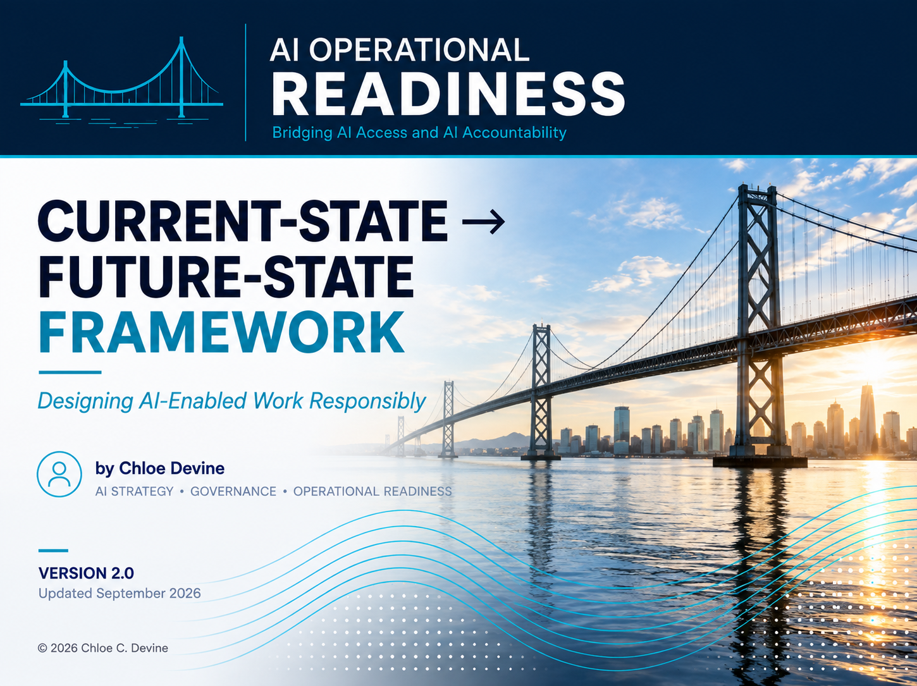

Slide 33
Framework Overview
AI Operational Readiness • Current-State – Future-State Framework
Designing AI-enabled work responsibly
Purpose
This framework helps teams translate prioritized AI opportunities into future-state workflows by mapping how work happens today, where friction exists, how AI may assist, where human oversight is required, and what business outcome the future state should create.
Core Flow
Current State → Pain Point → Opportunity → AI Assistance → Human Oversight → Business Outcome
What This Framework Helps Define
Component | Question It Answers
Current State | How does the work happen today?
Pain Point | What friction, delay, or burden exists?
Opportunity | What could be improved?
AI Assistance | What role could AI play?
Human Oversight | Where are reviews, approvals, escalations, interventions, or human accountability required?
Business Outcome | What business value should improve?
Resilience Check | What is the fallback path if the AI assistance becomes unavailable?
Guiding Philosophy
AI-enabled work should be designed before it is deployed.
Notes:
Participants
- PM
- Process Owner
- SMEs
- Architects
- Governance
- Security
- Data
- Sponsors

Slide 34
The Flow
AI Operational Readiness • Current-State – Future-State Framework
How work crosses from today’s reality to tomorrow’s value
Current State How it works today
↓
Pain Point Friction, delays, or burdens
↓
Opportunity Where value could be created
↓
AI Assistance How AI supports the work
↓
Human Oversight Where human review, approval, escalation, or intervention is required
↓
Business Outcome The value we expect to create
AI should assist work, not replace accountability.
Human oversight should be intentionally designed.
Future-state workflows should improve outcomes, not simply automate tasks.
Business value should be measurable
Design Principles

Slide 35
Current State
AI Operational Readiness • Current-State – Future-State Framework
Understanding how work happens today, including handoffs and workarounds
Current-State Elements | Proposed Design
Workflow: How the work is performed today, including handoffs and workarounds
Inputs: Information, documents, systems, and data required.
Outputs: Artifacts, decisions, reports, or actions produced.
Dependencies: People, teams, approvals, or systems the work relies upon.
Constraints: Pain points, delays, review burden, bottlenecks, or limitations.
Opportunity Signals
Manual work • Multiple handoffs • Repeated searching • Spreadsheet dependency • Context switching • Tribal knowledge • Duplicate effort • Waiting
Why This Matters
Future-state workflows should begin with understanding today’s work, not with selecting AI capabilities.
Notes:
Outputs - Constraints include:
Pain points
Delays
Review burden
Waiting
Organizational silos
Technology limitations
Policy restrictions

Slide 36
Opportunity
AI Operational Readiness • Current-State – Future-State Framework
Understanding what we are trying to improve
Opportunity Design Elements | Proposed Design
Intended Improvement | What should become faster, easier, more accurate, or more consistent.
Value Area | Productivity, quality, customer experience, risk reduction, cost, speed, or decision support.
AI Pattern | Primary and supporting capability pattern(s) identified during classification.
Action Implication | Inform, recommend, coordinate, act
Priority Signal | Why this opportunity was selected from the matrix.
Success Hypothesis | What we believe will improve if this opportunity is pursued.
Opportunity Signals
Repetition • Search burden • Review burden • Manual coordination • Handoffs • Drafting • Summarization • Decision support • Faster access to knowledge • Reduced rework
Why This Matters
AI opportunities should be defined around value creation, not tool capability.
Notes:
Outputs - Constraints include:
Pain points
Delays
Review burden
Waiting
Organizational silos
Technology limitations
Policy restrictions

Slide 37
AI Assistance
AI Operational Readiness • Current-State – Future-State Framework
Understanding how AI supports the work
AI Design Elements | Proposed Design
AI Role | Search, summarization, drafting, etc.
Inputs Required | Information needed by AI
Outputs Produced | Artifacts created by AI
Boundaries & Failure Conditions | What AI should not do, where it may fail, and when the workflow should not rely on it
Handoff | Where AI output is passed to a person, system, or the next workflow step.
Human Interaction | Where people verify, modify, use, or respond to AI output.
Fallback Path | How does work continue if AI assistance is unavailable or unusable?
Opportunity Signals
Search • Summarization • Drafting • Classification • Extraction • Analysis • Recommendations • Workflow routing • Reporting • Monitoring • Repeated language or knowledge work
Why This Matters
AI should have a defined role in the workflow before it is introduced into the work.
Notes:
Extraction = turning information buried inside documents, emails, images, or conversations into structured data that can be used elsewhere.
Example:
Invoice Processing:
Current State
Someone opens a PDF invoice and manually enters:
Vendor name
Invoice number
Amount
Due date
into SAP or Excel.
AI Assistance
Extract those fields automatically.

Slide 38
Human Oversight
AI Operational Readiness • Current-State – Future-State Framework
Understanding where accountability remains
Human Oversight Design Elements | Proposed Design
Review: Where must AI output be examined?
Approval: Where must human authorization occur before work proceeds?
Escalation: What conditions require the workflow to leave its normal path?
Intervention Authority: Where must the workflow be capable of pausing, overriding, or stopping?
Accountability: Where does consequential responsibility remain human?
Opportunity Signals
High-consequence decisions • Sensitive information • Customer impact • Legal or compliance exposure • External-facing outputs • Escalation triggers • Required approvals • Disagreement between AI and human judgment
Why This Matters
Human-in-the-loop is not a governance model unless the loop defines who reviews, who approves, who escalates, who can intervene, and who remains accountable.

Slide 39
Business Outcome
AI Operational Readiness • Current-State – Future-State Framework
Understanding what value should improve
Business Outcome Design Elements | Proposed Design
Success Measure | What metric will show whether the future state is working.
Expected Benefit | The value the team, customer, or business should receive.
Baseline | How the work performs today before AI is introduced.
Evidence Need | What would we need to observe to know whether the intended improvement occurred?
Success Condition | What would indicate that the future-state design is working as intended?
Opportunity Signals
Cycle time • Quality • Cost • Throughput • Customer outcome • Rework • Review Burden • Risk reduction • Consistency
Why This Matters
Future-state design should define the outcome AI is expected to improve and how that improvement will be recognized.

Slide 40
Future-State Blueprint
AI Operational Readiness • Current-State – Future-State Framework
Summarizing the proposed design
Area | Proposed Design Summary
Current State | What work looks like today
Future-State Workflow | How work will operate with AI
AI Role | What AI does
Human Handoffs | Where people enter/ re-enter the workflow
Oversight Points | Where review, approval, escalation, or intervention is required
Dependencies | What the future state relies upon
Resilience / Fallback | How work continues when AI cannot
Business Outcome | What should improve
Next Steps
Define decision rights, evidence requirements, pilot readiness, and governance operating rhythm.

Slide 41
Example Future-State Profile
AI Operational Readiness • Current-State – Future-State Framework
Illustrating the framework in practice
Opportunity: Meeting Summary Assistant
Area | Proposed Design Summary
Current State | Managers manually create meeting summaries and action items.
Opportunity | Reduce review burden and improve consistency.
AI Assistance | AI drafts summaries and extracts action items from meeting notes.
Human Oversight | Managers review and approve summaries before distribution. Escalation occurs for sensitive discussions. Managers remain accountable for communication.
Business Outcome | Reduce summary preparation time by 50% Increase follow-up consistency. Maintain quality through human review.
Design Element | Proposed Design
Future-state Workflow | AI drafts meeting summary and action items; manager reviews before distribution.
Primary Pattern | Summarization
Supporting Pattern(s) | Extraction
Action Implication | Inform
Inputs | Meeting transcript
Outputs | Draft summary and action items
Human Handoff | AI draft → Manager
Review Point | The manager verifies before distribution
Escalation Point | Sensitive topics leave the normal workflow for escalation
Fallback Path | Manager creates summary manually if AI assistance is unavailable
Success Measure | 50% reduction in preparation effort, improved follow-up consistency

Slide 42
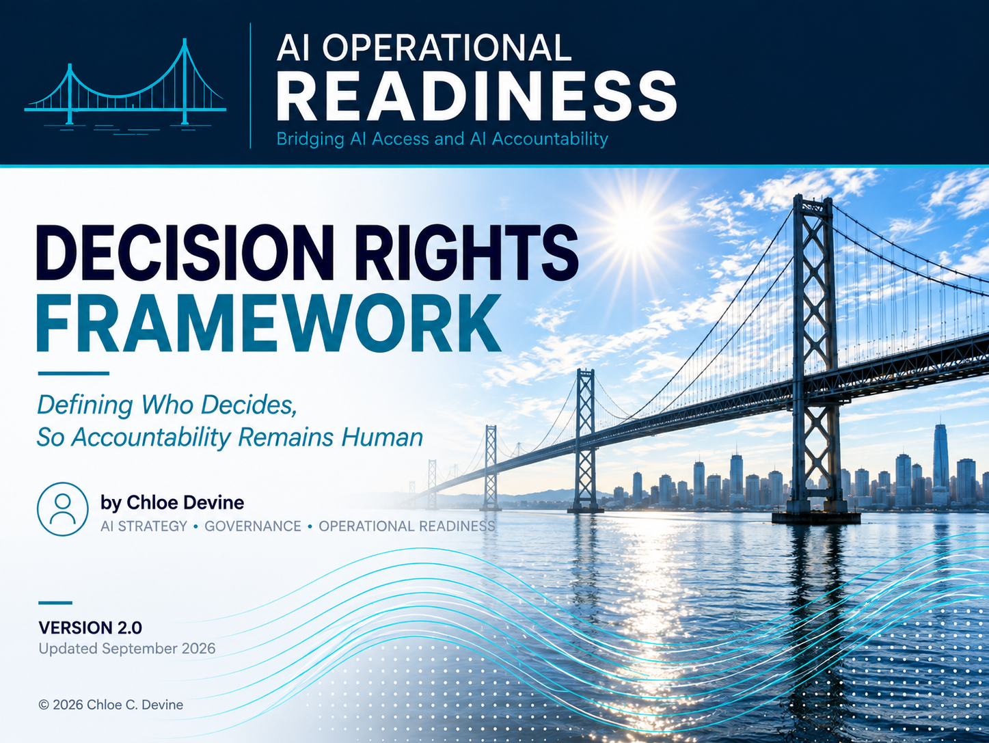

Slide 43
Framework Overview
AI Operational Readiness • Decision Rights Framework
Translating human oversight into operational controls
Purpose
Human oversight only becomes governance when organizations define who reviews, approves, escalates, intervenes, and remains accountable.
Core Decision Rights
Review • Approval • Escalation • Intervention Authority • Accountability • Lifecycle Decision Authority •
Authority Modification/ Restoration
What This Framework Helps Define
Component | Question It Answers
Review | Who verifies AI outputs before they are used?
Approval | Who authorizes actions or decisions?
Escalation | What conditions require additional attention?
Intervention Authority | Who can pause, override, or stop the process?
Accountability | Who remains responsible for outcomes?
Lifecycle Decision Authority | Who can authorize scale, redesign, pause, or retirement?
Authority Modification / Restoration | Who can narrow, suspend, restore, or expand AI operating authority?
Guiding Philosophy
Human involvement does not equal human accountability.
Guiding Principle – Access ≠ Authority
Access to information, tools, or systems does not, by itself, establish authority to act. Permission to change, commit, transfer, trigger, or execute must be explicitly defined.
Notes:
Participants
- PM
- Process Owner
- SMEs
- Architects
- Governance
- Security
- Data
- Sponsors

Slide 44
Why Human-in-the-Loop Isn’t Enough
AI Operational Readiness • Decision Rights Framework
Understanding the difference between participation and accountability
Human in the loop | Operational Governance
Human touches output | Review responsibilities defined
Human judgement is assumed | Approval authority defined
Exceptions handled ad hoc | Escalation paths defined
Individuals intervene informally | Intervention authority defined
Ownership is ambiguous | Accountability defined
Human involvement without decision rights is participation, not governance.

Slide 45
Review
AI Operational Readiness • Decision Rights Framework
Understanding who examines outputs
Questions
Review Owner – Who performs the review?
Verification Criteria – What are they expected to check?
Review Timing/ Frequency – When/how often must review occur?
Failure Response – What happens when the output doesn’t meet criteria?
Design Elements
Review Elements | Proposed Design
Review
Review Frequency
Validation Criteria
Evidence Retained
Escalation Trigger
Review Signals
Outputs with customer impact • Sensitive information • High-consequence decisions • External communications • Compliance exposure
Guiding Principle
Review defines how humans verify outputs before they become actions.
Notes:
Outputs - Constraints include:
Pain points
Delays
Review burden
Waiting
Organizational silos
Technology limitations
Policy restrictions

Slide 46
Approval
AI Operational Readiness • Decision Rights Framework
Understanding who authorizes use, distribution, execution, or exception
Questions
What requires approval—use, distribution, execution, or exception?
Who has authority to grant that approval?
What conditions must be true for the approval to apply?
What decisions must remain human?
Design Elements
Approval Elements | Proposed Design
Approval Owner – Who has the authority
Approval Scope – Use/ Distribution/ Execution/ Exception
Approval Conditions – What must be true for the approval to apply
Threshold
Approval method
Exceptions
Approval Signals
Irreversible actions • External commitments • Financial impact • Policy exceptions • Customer-facing outputs
Guiding Principle
Approval defines who authorizes actions before they occur.
Notes:
Outputs - Constraints include:
Pain points
Delays
Review burden
Waiting
Organizational silos
Technology limitations
Policy restrictions

Slide 47
Escalation
AI Operational Readiness • Decision Rights Framework
Understanding what triggers escalation, who receives it, and what response time applies
Questions
What triggers escalation?
Who receives escalations?
How quickly should issues be addressed?
What happens if escalation is unresolved?
Design Elements
Escalation Elements | Proposed Design
Escalation Trigger
Escalation Recipient
Response Time
Escalation Method
Resolution Path
Escalation Signals
Unexpected outputs • Human disagreement • Confidence thresholds • Regulatory concerns • Customer complaints
Guiding Principle
Exceptions should have predefined paths before they occur.
Notes:
Outputs - Constraints include:
Pain points
Delays
Review burden
Waiting
Organizational silos
Technology limitations
Policy restrictions

Slide 48
Intervention Authority
AI Operational Readiness • Decision Rights Framework
Understanding who can pause, override, shut down, rollback and restart
Questions
Who can pause?
Who can override?
Who can shut down the process?
Who decides to revert to manual work?
Who can authorize restart or restoration?
Design Elements
Intervention Elements | Proposed Design
Pause Authority
Override Authority
Shutdown / Disable Authority
Rollback Procedure
Restart / Restore Authority
Intervene Signals
Repeated failures • Unsafe behavior • Business disruption • Loss of trust • Escalation breakdown
Guiding Principle
Authority should exist before it is needed. Stopping AI is only half the governance problem. Someone also has to possess legitimate authority to restore it.
Notes:
Outputs - Constraints include:
Pain points
Delays
Review burden
Waiting
Organizational silos
Technology limitations
Policy restrictions

Slide 49
Accountability
AI Operational Readiness • Decision Rights Framework
Understanding who owns outcomes and consequences
Questions
Who owns the process?
Who owns customer impact?
Who owns errors?
Who owns the consequences if something goes wrong?
Design Elements
Accountability Elements | Proposed Design
Process Owner
Business Owner
Risk & Compliance Owner
Accountability Signals
Customer impact • Process ownership • Regulatory obligations • Cross-functional dependencies
Guiding Principle
Accountability remains human, even when work is AI-assisted. Supporting roles can be many, but ultimately accountability should be explicit.
Notes:
Outputs - Constraints include:
Pain points
Delays
Review burden
Waiting
Organizational silos
Technology limitations
Policy restrictions

Slide 50
Lifecycle & Authority Decisions
AI Operational Readiness • Decision Rights Framework
Defining who can change whether and how AI-enabled work continues
Lifecycle Decision Authority:
Questions
Who can authorize scale, redesign, pause, or retirement?
Lifecycle Decision Elements | Proposed Design
Decision Owner
Decision Scope – Scale / Redesign / Pause / Retire
Decision Basis – What evidence or conditions inform the decision?
Authority Modification / Restoration:
Questions
Who can authorize changes to the AI’s permitted operating authority, including narrowing, suspending, restoring, or expanding it?
Authority Modification Elements | Proposed Design
Authority Owner
Modification Scope – Narrow / Suspend / Restore / Expand
Conditions / Evidence Required
Notes:
Outputs - Constraints include:
Pain points
Delays
Review burden
Waiting
Organizational silos
Technology limitations
Policy restrictions

Slide 51
Example Decision Rights Profile
AI Operational Readiness • Decision Rights Framework
Illustrating the framework in practice
Opportunity: Meeting Summary Assistant
Decision Area | Proposed Design Summary
Review | Manager verifies summaries
Approval | Manager approves distribution
Escalation | Sensitive topics escalate to HR
Intervention Authority | Manager may disable AI assistance
Accountability | Manager remains accountable for communication quality
Lifecycle Decision Authority | Director determines expansion to additional teams
Authority Modification / Restoration | System owner authorizes restoration or changes to AI operating authority.
AI Action Boundary
What may AI do without additional authorization?
Action Level: Inform
Permitted Action Boundary: AI may draft summaries and action items but may not distribute them without human authorization.
Guiding Principle
Decision rights should be defined before AI-enabled work begins.

Slide 52
Decision Rights in the AI Operational Readiness Journey
AI Operational Readiness • Decision Rights Framework
Discovery
↓
Prioritize
↓
Classify
↓
Design
↓
Govern
↓
Evidence
↓
Prepare
↓
Operate
Next Step
Define what evidence should be retained to support accountability and operational governance.

Slide 53
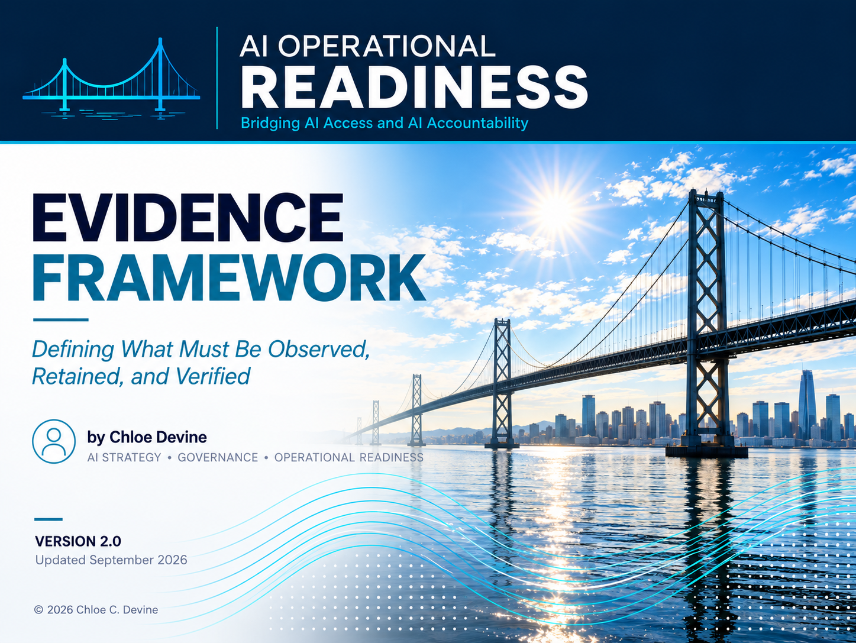

Slide 54
Framework Overview
AI Operational Readiness • Evidence Framework
Translating accountability into observable evidence
Purpose
Governance becomes operational when evidence can support, reconstruct, and test decisions and actions. The framework defines what to observe, retain, and verify across value, quality, risk, adoption, decisions, and governance.
Core Evidence Areas
Value • Quality • Risk • Adoption • Decision • Governance Provenance • Decision Provenance
What This Framework Helps Define
Component | Question It Answers
Value Evidence | Are we creating measurable value?
Quality Evidence | Are outputs meeting expectations?
Risk Evidence | Are issues or failures occurring?
Adoption Evidence | Is the solution being used effectively?
Decision | What information supports governance decisions?
Governance Provenance | What evidence establishes what was reviewed, approved, conditioned, mitigated, and owned?
Decision Provenance | Can we reconstruct why a consequential action or decision was considered legitimate?
Guiding Philosophy
Governance becomes operational when decisions are supported by evidence.
Notes:
Participants
- PM
- Process Owner
- SMEs
- Architects
- Governance
- Security
- Data
- Sponsors

Slide 55
Why Evidence Isn’t Optional
AI Operational Readiness • Evidence Framework
Understanding the difference between assumptions and observability
Assumption | Operational Evidence
AI seems useful | Value is measured
Quality is assumed | Quality is evaluated
Risk is unknown | Risks are monitored
Usage is uncertain | Adoption is measured
Decisions rely on opinion | Decisions rely on evidence
“We have logs” | Evidence can reconstruct the relevant decision and system state
Evidence Quality Check
Integrity – Can alteration be detected?
Provenance – Where did the evidence come from?
Traceability – Can it be connected to the relevant decision?
Version Alignment – Does it describe what was operating?
Continued Relevance / Freshness – Does it still support the decision now?
Guiding Philosophy
Evidence makes operational decisions observable, supportable, and reconstructable.

Slide 56
Value Evidence
AI Operational Readiness • Evidence Framework
Understanding what business value is created
Questions
What outcome should be improved?
What baseline exists?
How will value be measured?
What constitutes success?
Design Elements
Value Elements | Proposed Design
Success Measure
Baseline
Target Improvement
Measurement Frequency
Reporting Owner
Value Signals
Cycle time • Reduced effort • Cost reduction • Increased throughput • Customer satisfaction • Quality improvements
Guiding Principle
Value should be measurable before it is celebrated.

Slide 57
Quality Evidence
AI Operational Readiness • Evidence Framework
Understanding whether outputs meet expectations
Questions
How is quality verified?
What defects matter?
What thresholds exist?
How often is quality reviewed?
Design Elements
Quality Elements | Proposed Design
Quality Metric
Acceptance Criteria
Review Frequency
Error Threshold
Verification Owner
Quality Signals
Corrections • Rework • Hallucinations • Inconsistent outputs • Escalations • User complaints
Guiding Principle
Quality should be demonstrated, not assumed.

Slide 58
Risk Evidence
AI Operational Readiness • Evidence Framework
Understanding where failures and concerns emerge
Questions
What risks should be monitored?
What incidents should be recorded?
What thresholds trigger action?
What trends matter?
Design Elements
Risk Elements | Proposed Design
Risk Metric
Monitoring Frequency
Escalation Threshold
Incident Tracking
Owner
Risk Signals
Sensitive information • Compliance concerns • Customer impact • Repeated failures • Unexpected behavior •
Policy/control exceptions • Threshold breaches
Guiding Principle
Risks should be observed before they become incidents.

Slide 59
Adoption Evidence
AI Operational Readiness • Evidence Framework
Understanding how people interact with the solution
Questions
Is the solution being used?
Are users bypassing it?
Where does friction exist?
Is trust increasing or declining?
Has AI reduced work or shifted effort to reviewers?
What human effort is required to verify, correct, or manage AI output?
Design Elements
Adoption Elements | Proposed Design
Usage Metric
Satisfaction Measure
Friction Indicator
Training Need
Adoption Owner
Review Burden
Adoption Signals
Low usage • Workarounds • Complaints • Declining trust • Shadow processes
Guiding Principle
Adoption reveals whether the design works in practice.

Slide 60
Decision Evidence
AI Operational Readiness • Evidence Framework
Understanding what evidence supports lifecycle and governance decisions
Questions
What information supports scaling?
What evidence supports pausing?
What evidence supports redesigning?
What evidence supports retirement?
What rationale should be retained with the decision?
Design Elements
Decision Elements | Proposed Design
Scale Criteria
Pause Criteria
Redesign Criteria
Retirement Criteria
Decision Owner
Decision Rationale
Decision Signals
Declining quality • Escalations • Strong value • Weak adoption • Risk exposure
Guiding Principle
Governance decisions should rely on evidence, not optimism.

Slide 61
Governance & Decision Provenance
AI Operational Readiness • Evidence Framework
Preserving what was decided, why it was legitimate, and the conditions that applied
Governance Provenance Questions
What governance decision was made?
What evidence supported it?
Who reviewed or approved it?
What conditions, mitigations, or exceptions applied?
What system/version did the decision apply to?
Evidence Elements | Proposed Design
Decision / Approval
Supporting Evidence
Owner / Approver
Conditions / Mitigations
Applicable Version / State
Decision Provenance Questions
Can we reconstruct why a consequential action was allowed to proceed?
What evidence, context, policy, authority, and approval applied?
What was executed, and what outcome resulted?
Evidence Elements | Proposed Design
Initiating Event / Request
Evidence & Context
Applicable Policy / Authority
Approval / Exception / Override
Action Executed
Resulting Outcome

Slide 62
Example Evidence Profile
AI Operational Readiness • Evidence Framework
Illustrating the framework in practice
Opportunity: Meeting Summary Assistant
Evidence Area | Proposed Design Summary
Value | 50% reduction in summary preparation time
Quality | Manager correction rate <10%
Risk | Sensitive-topic escalation count and policy exception rate
Adoption | 80% team utilization
Decision | Expand after three successful months
Governance Provenance | Manager approval, escalation decisions, applicable conditions, and workflow version retained
Decision Provenance | For consequential exceptions, retain the supporting evidence, applicable authority, decision, and resulting action.
Guiding Principle
Evidence should support decisions throughout the lifecycle.

Slide 63
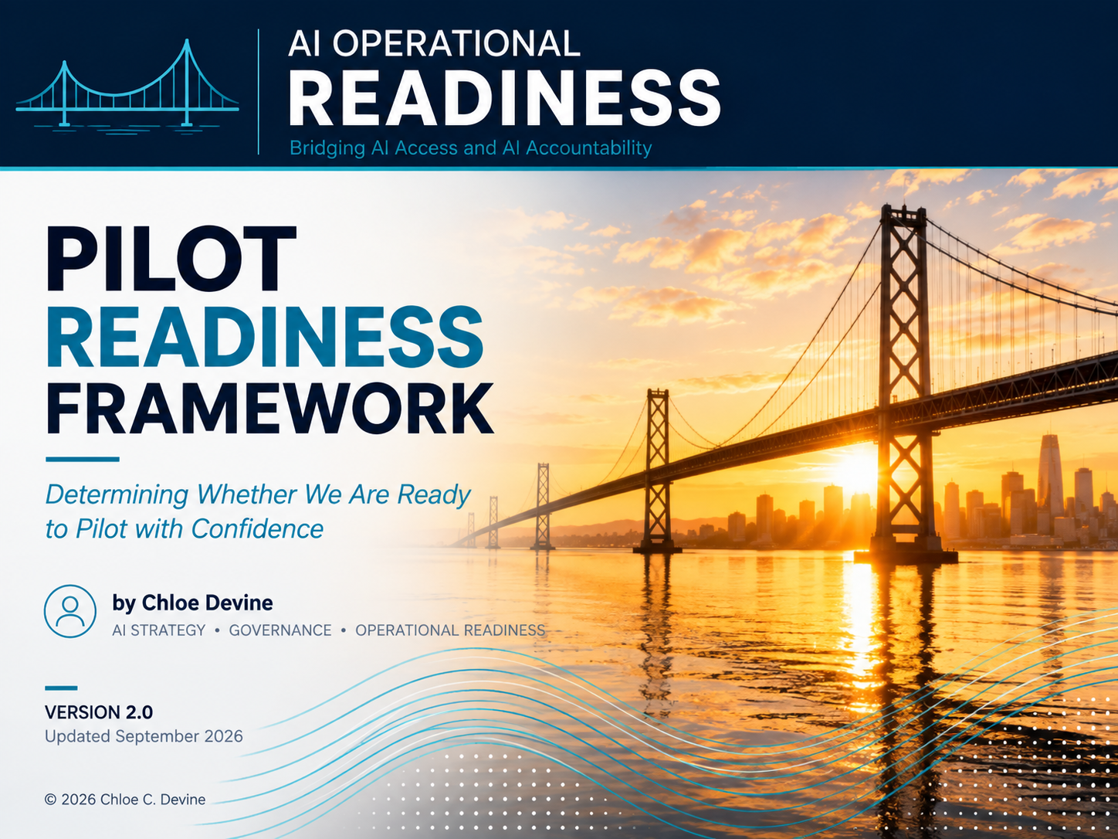

Slide 64
Framework Overview
AI Operational Readiness • Pilot Readiness Framework
Translating design, governance, and evidence into a pilot decision
Purpose
This framework determines whether an AI-enabled operating model is ready for controlled testing by verifying business fit, workflow design, technical readiness, governance, evidence, operational support, and pilot decision criteria.
Core Flow
Business Fit → Workflow Readiness → Technical Readiness → Governance Readiness → Evidence Plan → Operational Support → Pilot Decision
What This Framework Helps Define
Component | Question It Answers
Business Fit | Is this pilot worth running?
Workflow Readiness | Has the future-state workflow been defined?
Technical Readiness | Can the solution function reliably enough to test?
Governance Readiness | Are decision rights, escalation, and intervention defined?
Evidence Plan | Do we know what must be observed, retained, and verified?
Operational Support | Are people, support paths, and fallback plans ready?
Pilot Decision | Should we proceed, pause, redesign, or defer?
Guiding Philosophy
A pilot should test a defined operating model, not an undefined idea.
Notes:
Participants
- PM
- Process Owner
- SMEs
- Architects
- Governance
- Security
- Data
- Sponsors

Slide 65
Why Pilots Fail
AI Operational Readiness • Pilot Readiness Framework
Understanding the difference between experimentation and readiness
Experimentation Without Readiness | Pilot Readiness
AI use case is interesting | Business problem is defined
Workflow is assumed | Future-state workflow is mapped
Human oversight is informal | Decision rights are assigned
Success is anecdotal | Evidence plan is defined
Issues are handled reactively | Escalation and fallback paths are prepared
Pilot starts because the tool works | Pilot starts because the operating model is ready
Fallback is assumed | Fallback is documented and testable
Controls exist on paper | Controls can be exercised
Guiding Philosophy
A working tool is not the same as a pilot-ready workflow.

Slide 66
Business Fit
AI Operational Readiness • Pilot Readiness Framework
Understanding whether the pilot is worth running
Questions
What business problem does the pilot address?
Why is this use case worth testing now?
What value should the pilot create?
Who is sponsoring the pilot?
Design Elements
Business Fit Elements | Proposed Design
Business Problem
Intended Value
Sponsor
Success Hypothesis
Priority Rationale
Business Fit Signals
Clear pain point • High-frequency work • Strong business sponsor • Measurable outcome • Prioritized opportunity • Clear user group
Guiding Principle
Pilots should be selected for business value, not tool novelty.

Slide 67
Workflow Readiness
AI Operational Readiness • Pilot Readiness Framework
Understanding whether the future-state workflow is defined
Questions
Has the current state been documented?
Has the future-state workflow been designed?
Where does AI assist?
Where do humans review, approve, or intervene?
Is AI’s permitted action boundary reflected in the workflow?
What happens when the workflow encounters an exception?
Workflow Readiness Elements | Proposed Design
Current-State Workflow
Future-State Workflow
AI Role
Human Handoff
Fallback Path
Action Boundary
Exception Path
Workflow Readiness Signals
Current-state ambiguity • Undefined handoffs • Missing fallback path • Manual workaround required • Human review unclear • Process owner uncertainty
Guiding Principle
AI should enter a designed workflow, not an assumed one.

Slide 68
Technical Readiness
AI Operational Readiness • Pilot Readiness Framework
Understanding whether the solution can function reliably enough to test
Questions
What model, tool, or platform will be used?
What inputs does the solution require?
Are data, documents, and system connections available?
What limitations or failure modes are expected?
Can required approvals, pauses, restrictions, or intervention points actually be enforced in the pilot environment?
Can the pilot produce the evidence needed to evaluate the workflow and governance model?
Technical Readiness Elements | Proposed Design
Tool / Model / Platform
Required Inputs
Integration Needs
Known Limitations
Test Environment
Required Controls/Enforcement Points
Required Observation/ Logging
Technical Readiness Signals
Data access gaps • Poor input quality • Integration uncertainty • Model limitations • Unstable workflow •
Security concerns
Guiding Principle
Technical readiness means the solution can be tested safely, not that it is perfect.

Slide 69
Governance Readiness
AI Operational Readiness • Pilot Readiness Framework
Understanding whether oversight is ready before launch
Questions
Who reviews AI outputs?
Who approves use or distribution?
What triggers escalation?
Who can pause, override, stop, or restore AI-enabled operation?
Who remains accountable?
Are approval conditions understood and reflected in the pilot?
Who can suspend, restore, or modify AI operating authority during the pilot?
Governance Readiness Elements | Proposed Design
Review Owner
Approval Owner
Escalation Path
Intervention Authority
Accountability Owner
Approval Conditions
Authority Modification/ Restoration
Governance Readiness Signals
Undefined review • Approval ambiguity • No escalation path • No pause criteria • Shared accountability • Sensitive or external-facing outputs
Guiding Principle
Oversight should be operational before the pilot begins.

Slide 70
Evidence Readiness
AI Operational Readiness • Pilot Readiness Framework
Understanding whether evidence can be produced and evaluated during the pilot
Questions
What baseline exists?
What evidence will show value?
What evidence will show quality?
What evidence will show risk?
What evidence will support the scale decision?
What evidence will show adoption and human review burden?
What governance or decision evidence must be retained?
How will required evidence be captured during the pilot?
Evidence Readiness Elements | Proposed Design
Baseline
Value Metric
Quality Metric
Risk Metric
Scale Criteria
Adoption/Review Burden
Governance/Decision Evidence
Evidence Owner/Capture Method
Evidence Readiness Signals
Missing baseline • Anecdotal success • Unclear quality threshold • No risk tracking • No adoption measure •
No scale criteria
Guiding Principle
Evidence should be defined before the pilot produces results.

Slide 71
Operational Support
AI Operational Readiness • Pilot Readiness Framework
Understanding whether people and support paths are ready
Questions
Who supports users during the pilot?
How will issues be reported?
What training or guidance is needed?
What happens if the AI system becomes unavailable?
How will lessons be captured?
Has the fallback or recovery path been tested or walked through?
Operational Support Elements | Proposed Design
Support Owner
User Guidance
Issue Reporting Path
Fallback / Continuity Plan
Lessons Capture
Fallback/Recovery Test
Operational Support Signals
No support owner • Confused users • Silent failures • Workarounds • AI dependency • No fallback path •
Lessons not captured • Untested fallback
Guiding Principle
A pilot should be supported as an operating workflow, not treated as a side experiment.

Slide 72
Pilot Boundaries & Learning Plan
AI Operational Readiness • Pilot Readiness Framework
Defining what will be tested, with whom, for how long, and what the pilot must teach us
Pilot Boundary Element Design
Questions
Pilot Boundary Elements | Proposed Design
Pilot Population/User Group
Workflow Scope
System/Data Scope
Duration
Exclusions
Stop/Pause Conditions
Who and what is included in the pilot?
What systems, data, workflows, or actions are in scope?
What remains explicitly out of scope?
How long will the pilot run?
What conditions require the pilot to pause or stop?
Learning Plan Element Design
Questions
Learning Plan Elements | Proposed Design
Learning Questions
Key Assumptions
Evidence Required
Review Point
Decision After Pilot
What assumptions are we testing?
What must we learn before scale is considered?
What evidence would challenge the proposed operating model?

Slide 73
Pilot Decision
AI Operational Readiness • Pilot Readiness Framework
Understanding whether to proceed, pause, redesign, or defer
Questions
Is the business case clear?
Is the workflow defined?
Are governance controls assigned and executable?
Can the required evidence actually be captured and evaluated?
Are support and fallback paths in place?
What unresolved dependencies or conditions must be accepted before proceeding?
Pilot Decision Elements | Proposed Design
Proceed Criteria
Pause Criteria
Redesign Criteria
Defer Criteria
Decision Owner
Unresolved Dependencies/Conditions
Pilot Decision Signals
Clear sponsor • Defined workflow • Assigned decision rights • Evidence plan ready • Support owner identified • Fallback path available
Guiding Principle
Pilot readiness is a decision, not a feeling.

Slide 74
Example Pilot Readiness Profile
AI Operational Readiness • Pilot Readiness Framework
Illustrating the framework in practice
Opportunity: Meeting Summary Assistant
Readiness Area | Proposed Design Summary
Business Fit | Reduced summary preparation time and improved follow-up consistency.
Workflow Readiness | AI draft summaries; manager reviews before distribution
Technical Readiness | Meeting transcripts available; required logging enabled; pilot limited to internal meetings
Governance Readiness | Manager reviews and approves distribution, escalates sensitive topics, and may suspend AI assistance
Evidence Readiness | Track time saved, correction rate, user satisfaction, and escalation count
Operational Support | Provide user guidance, issue reporting path, and manual fallback
Pilot Decision | Proceed with 30-day internal pilot
Pilot Boundaries & Learning | 30-day internal pilot with selected managers; test time savings, correction burden, escalation handling, and whether review controls work in practice.
Guiding Principle
A pilot should validate the workflow, controls, evidence, and value – not just the technology.

Slide 75
Pilot Readiness in the AI Operational Readiness Journey
AI Operational Readiness • Pilot Readiness Framework
Discovery
↓
Prioritize
↓
Classify
↓
Design
↓
Govern
↓
Evidence
↓
Prepare ↓ Operate
Define the governance operating rhythm for monitoring, learning, escalation, and continuous improvement.
Next Step
Guiding Principle
Responsible scaling begins with a pilot that is designed to teach the organization:
What works,
What doesn’t,
What needs to change,
And whether scaling is justified.
Notes:
The goal is to learn:
- Does this workflow actually create value?
- Do users trust it?
- Are the outputs good enough?
- Are the review and approval processes sufficient?
- What risks appear in practice?
- Are the metrics meaningful?
- Is adoption occurring?
- Are the assumptions we made during design correct?
- Should we scale, redesign, pause, or retire the solution?
- Do the governance controls work as intended in practice?
- Can the organization produce the evidence needed to support its decisions?

Slide 76
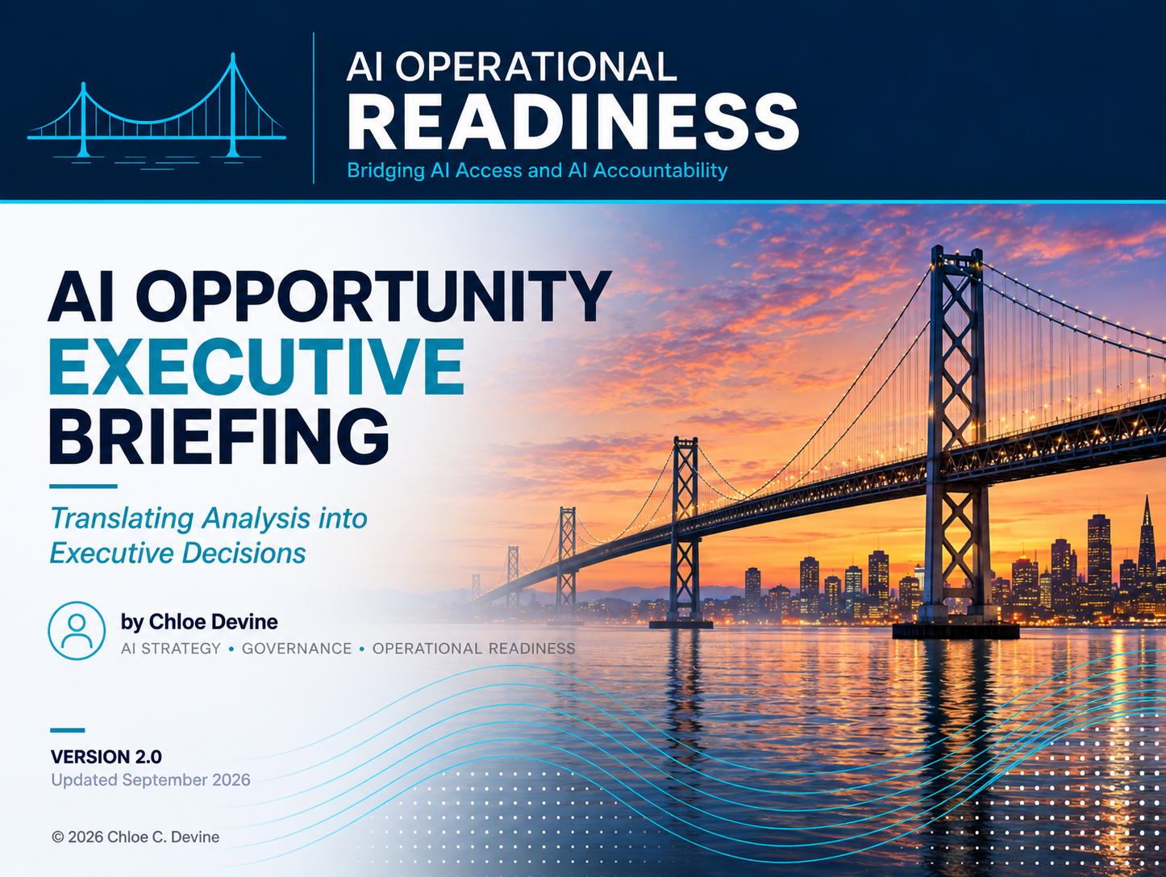

Slide 77
Briefing Overview
AI Operational Readiness • Executive Briefing
Communicating the recommendation, rationale, and decision needed
Purpose
This briefing helps teams communicate a selected AI opportunity to executive stakeholders by summarizing the business problem, proposed future state, AI role, governance model, evidence plan, pilot readiness, and decision needed.
Core Flow
Problem → Opportunity → Design → Governance → Evidence → Readiness → Decision
What This Briefing Helps Communicate
Component | Question It Answers
Business Problem | What issue are we addressing?
Recommended Opportunity | What AI-enabled opportunity are we proposing?
Future-State Design | How will the work change?
Governance Model | Who reviews, approves, escalates, intervenes, and remains accountable?
Evidence Plan | How will value, qualify, risk, and adoption be measured?
Pilot Readiness & Recommendation | Are we ready to pilot, and what should we test and learn?
Decision Requested | What do we need leadership to approve?
Guiding Philosophy
Executive briefings should turn analysis into decisions.

Slide 78
Executive Summary
AI Operational Readiness • Executive Briefing
Providing the recommendation in one view
Briefing Area | Summary
Recommendation | Proceed with a limited pilot / defer / redesign
Opportunity | Name of AI opportunity
Business Value | Expected benefit
Governance | Key oversight model
Evidence | Measures to evaluate success
Decision Needed | Approval, funding, sponsorship, or alignment
Readiness | Key readiness condition, dependency, or limitation
Guiding Philosophy
Executives should understand the recommendation before they see the details.

Slide 79
Business Problem
AI Operational Readiness • Executive Briefing
Clarifying the problem before proposing AI
Questions
What work is painful, slow, costly, risky, or inconsistent?
Who is affected?
What happens if this problem remains unresolved?
What evidence supports the problem?
Problem Signals
Rework • Delays • Manual effort • Search burden • Review burden • Customer impact • Compliance exposure • Bottlenecks
Guiding Principle
AI should be proposed in response to a business problem, not as a standalone capability.

Slide 80
Current State
AI Operational Readiness • Executive Briefing
Showing how the work happens
Current-State Area | Summary
Workflow | How work happens today
Inputs | Information, documents, systems, or data used
Outputs | What the process produces
Dependencies | People, approvals, systems, or teams involved
Continuity/ Criticality | What work must continue if AI or a supporting dependency is unavailable?
Constraints | Pain points, delays, bottlenecks, or limitations
Guiding Principle
Executives should see the work before they approve changing it.

Slide 81
Recommended AI Opportunity
AI Operational Readiness • Executive Briefing
Explaining what should change and why this opportunity was selected
Opportunity Area | Summary
Opportunity | Proposed AI-enabled use case
Source Theme | Where it emerged from discovery
Priority Rationale | Why it scored high or was selected
AI Pattern | Primary AI pattern and supporting pattern(s)
Action/Authority Implication | Inform/Recommend/Coordinate/Act
Expected Improvement | What should become faster, easier, safer, or more consistent.
Opportunity Signals
High frequency • High pain • Strong AI fit • Measurable value • Manageable risk • Clear sponsor
Guiding Principle
The best AI opportunities balance value, fit, complexity, and risk.

Slide 82
Future-State Design
AI Operational Readiness • Executive Briefing
Showing how work will change with AI assistance
Future-State Area | Summary
AI Role | What AI will do
Human Role | What humans will review, approve, or decide
Workflow Change | How the process changes
Human Handoff | Where AI assistance ends
Fallback Path | What happens if AI is unavailable or unsuitable
Review/Approval Point | Where review or authorization occurs before consequential action
Success Outcome | What should materially improve if the design works
Guiding Principle
Future-state workflows should improve outcomes, not simply automate tasks.

Slide 83
Governance Model
AI Operational Readiness • Executive Briefing
Defining who decides and where accountability remains
Decision Area | Proposed Design
Review | Who verifies outputs
Approval | Who authorizes use or distribution
Escalation | What triggers escalation and who receives it
Intervention Authority | Who can pause, override, or stop the process
Accountability | Who owns outcomes and consequences
AI Action Boundary | What AI may do without additional authorization
Authority Modification/ Restoration | Who may narrow, suspend, restore, or expand AI operating authority
Governance Signals
Sensitive information • External-facing outputs • High-consequence decisions • Shared ownership • Escalation triggers • Compliance exposure
Guiding Principle
Human involvement without decision rights is participation, not governance.

Slide 84
Evidence Plan
AI Operational Readiness • Executive Briefing
Defining how success, quality, risk, and adoption will be measured
Evidence Area | Measure
Value | Time saved, cost reduced, throughput increased, quality improved
Quality | Accuracy, correction rate, acceptance rate, rework
Risk | Escalations, incidents, sensitive outputs, unexpected behavior
Adoption | Usage, satisfaction, workarounds, trust
Decision Evidence | Evidence required to scale, pause, redesign, or retire
Governance | Approvals, escalations, interventions, exceptions, and authority changes
Guiding Principle
Governance decisions should rely on sufficient, trustworthy evidence – not optimism.

Slide 85
Pilot Readiness & Recommendation
AI Operational Readiness • Executive Briefing
Defining whether the organization is ready to test and what the pilot should learn
Pilot Area | Recommendation
Scope | Team, process, use case, or timeframe
Participants | Pilot users and support owners
Duration | Proposed pilot length
Success Criteria | What would justify scaling
Pause Criteria | What would require stopping or redesign
Learning Goals | What the pilot is designed to teach the organization
Readiness Conditions | What must be true before the pilot begins
Review Point | When evidence will be reviewed and who decides what happens next
Pilot Signals
Defined scope • Clear sponsor • Assigned decision rights • Evidence plan ready • Support path defined • Fallback path available
Guiding Principle
A pilot should validate the workflow controls, evidence, and value, not just the technology.

Slide 86
Risk, Dependencies, and Open Questions
AI Operational Readiness • Executive Briefing
Clarifying what must be managed before approval
Area | Consideration | Owner / Next Step
Risk | Key risk or concern
Dependency | System, data, team, vendor, or policy dependency
Open Question | Decision or clarification needed
Mitigation | Planned control or response
Continuity | Critical dependency, fallback, or recovery concern.
Guiding Principle
Unresolved risks should be visible before decisions are made.

Slide 87
Decision Requested
AI Operational Readiness • Executive Briefing
Making the executive ask explicit
Decision Needed | Recommendation
Proceed / Pause / Redesign / Defer | Recommended decision
Approve Pilot Scope | Scope and boundaries
Confirm Sponsor | Executive or business sponsor
Confirm Owners | Process, governance, technical, and support owners
Confirm Next Step | Workshop, pilot, funding, or design completion
Confirm Decision Authority | Who can approve, pause, redesign, scale or retire
Guiding Principle
Executive briefings should end with a clear decision, not a general discussion.

Slide 88
Next Steps
AI Operational Readiness • Executive Briefing
Translating executive direction into action
Next Step | Owner | Timing
Finalize pilot scope
Confirm decision rights
Define evidence collection
Prepare support, fallback, and continuity paths
Schedule pilot review
Guiding Principle
The value of an executive briefing is measured by the clarity of the next action.

Slide 89
About this Toolkit
Companion Resource
This toolkit is designed to be used with the AI Operational Readiness and Governance Practitioner Guide.
For the complete methodology, principles, and lifecycle content, access the Practitioner Guide here: Access the AI Operational Readiness & Governance Practitioner Guide on Zenodo
Use & Attribution
© 2026 Chloe C. Devine. All rights reserved. You may use this resource in its original form for practitioner reference and application. When referenced, reproduced, presented, or incorporated into other work, attribution to Chloe C. Devine and the AI Operational Readiness and Governance Practitioner Guide is required.
Practitioners may complete and use the provided fields/templates for their own internal application. You may not alter or republish the underlying framework, instructional content, attribution, or methodology as a modified work without permission.
AI Assistance Disclosure
AI tools supported research synthesis, content organization, editing, and design assistance in developing this resource. The framework, methodology, practitioner guidance, and final editorial decisions were developed and reviewed by Chloe C. Devine.
Practitioner Notice
This resource provides practical guidance and templates and is not a substitute for legal, regulatory, security, compliance, or other professional advice. Organizations should adapt its application to their specific context, risks, policies, and obligations.
AI Operational Readiness & Governance Toolkit | Version 2.0 | September 2026
DOI: 10.5281/zenodo.22973254
https://doi.org/10.5281/zenodo.22973254

